Slide 1


CREDIT RISK ANALYTICS
Loan Default Risk Classification
Predictive Modeling and Strategic Technical Benchmarking
Sreekutty Santhosh • Laniya Mohan • Theertha Vijayachandran

Slide 2





DATA METHODOLOGY
Engineering
Preprocessing
Development of critical financial indicators: Debt-to-Income, Annuity-to-Income, and Payment Ratios.
SMOTE Strategy
Execution of median/mode imputation and removal of features with high sparsity (>50% missingness).
Utilized Synthetic Minority Over-sampling to address the inherent skew in default distributions.

Slide 3
TECHNICAL BENCHMARKING
Model Architecture | Accuracy | Precision | Recall | ROC-AUC
Logistic Regression | 0.6624 | 0.1356 | 0.5921 | 0.6792
Random Forest Classifier | 0.6641 | 0.1351 | 0.5851 | 0.6784
LightGBM (Gradient Boost) | 0.9193 | 0.0000 | 0.0000 | 0.6284
Note: Logistic Regression is the champion model, offering the highest Recall and ROC-AUC for risk identification.

Slide 4

THE RECALL PRIORITY
Safety over Accuracy
In lending, the cost of a missed default (Type II Error) is significantly higher than a false rejection. Our framework prioritizes the model that actually "detects" the defaulters.
The LightGBM Failure
Despite 91% accuracy, LightGBM failed to identify any defaults (Recall = 0). It optimized for the majority class, making it useless for proactive credit risk mitigation.

Slide 5

KEY RISK PREDICTORS
Critical Indicators
EXT_SOURCE (1, 2, 3): Third-party bureau ratings.
Days Employed: Work history stability.
Credit-to-Annuity: Repayment burden.

Slide 6
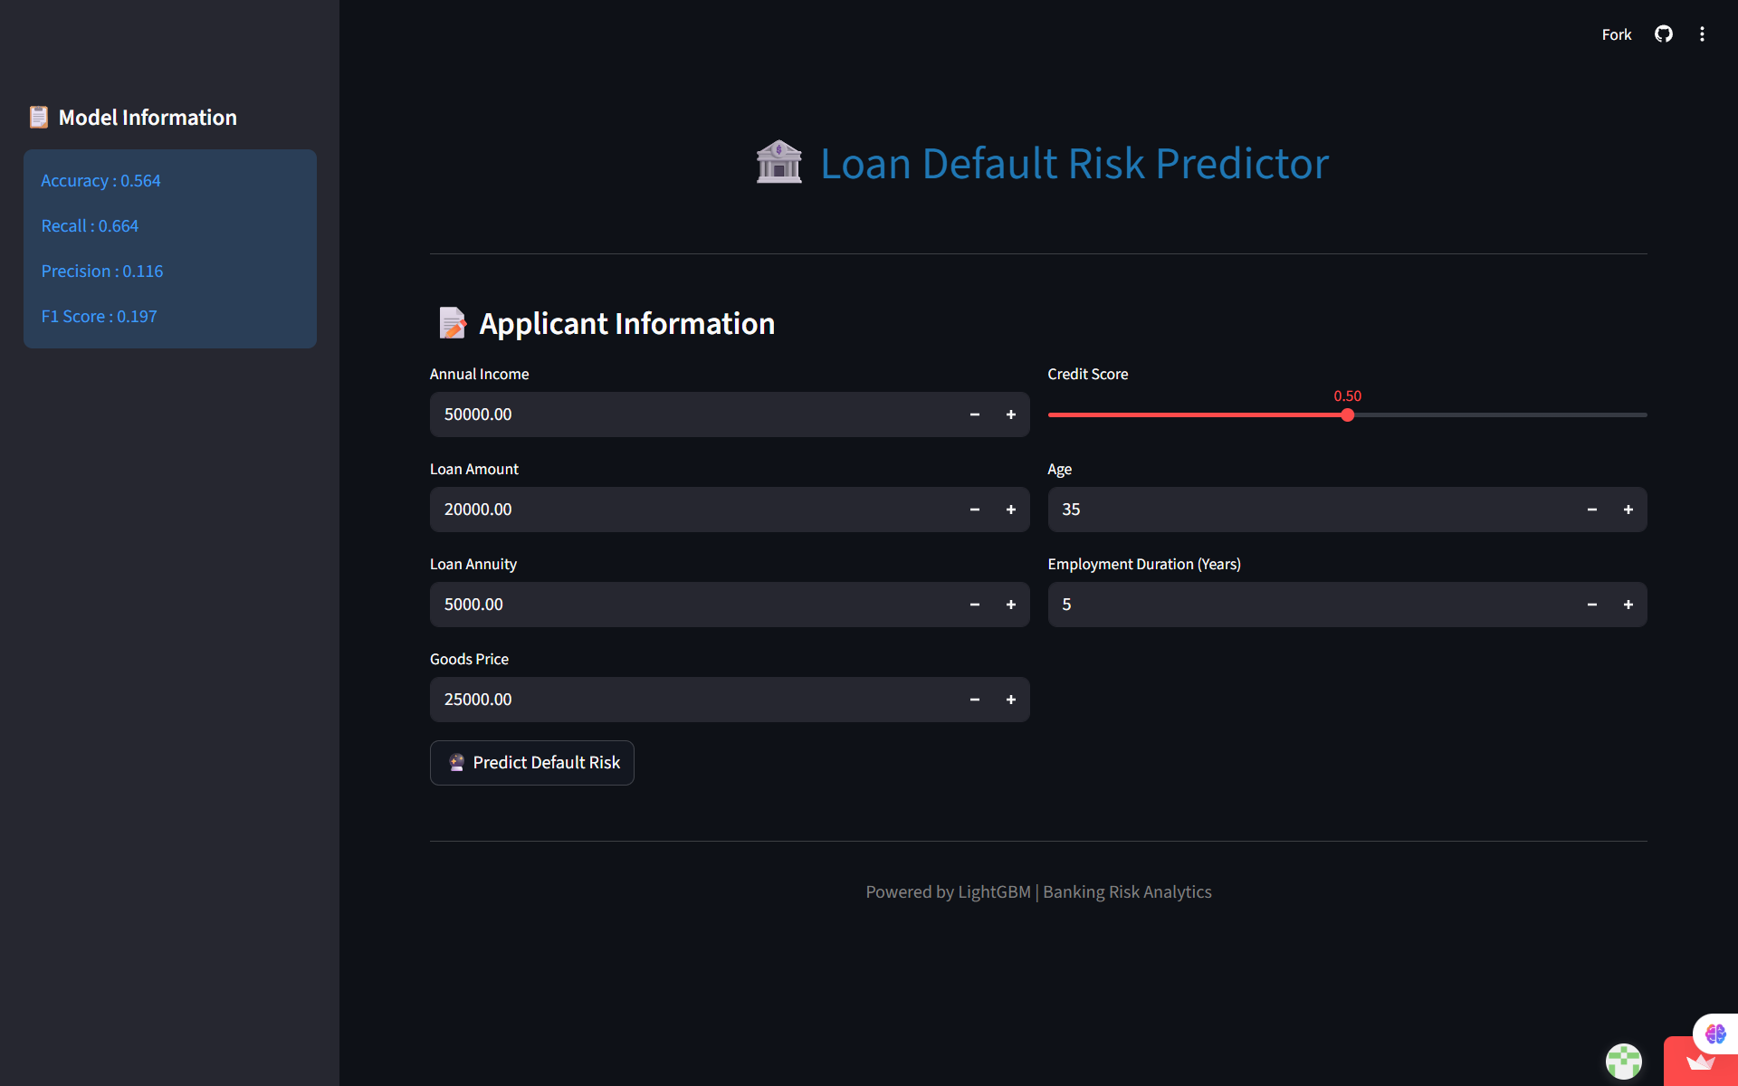
DEPLOYMENT ENVIRONMENT
Main System Dashboard

Slide 7
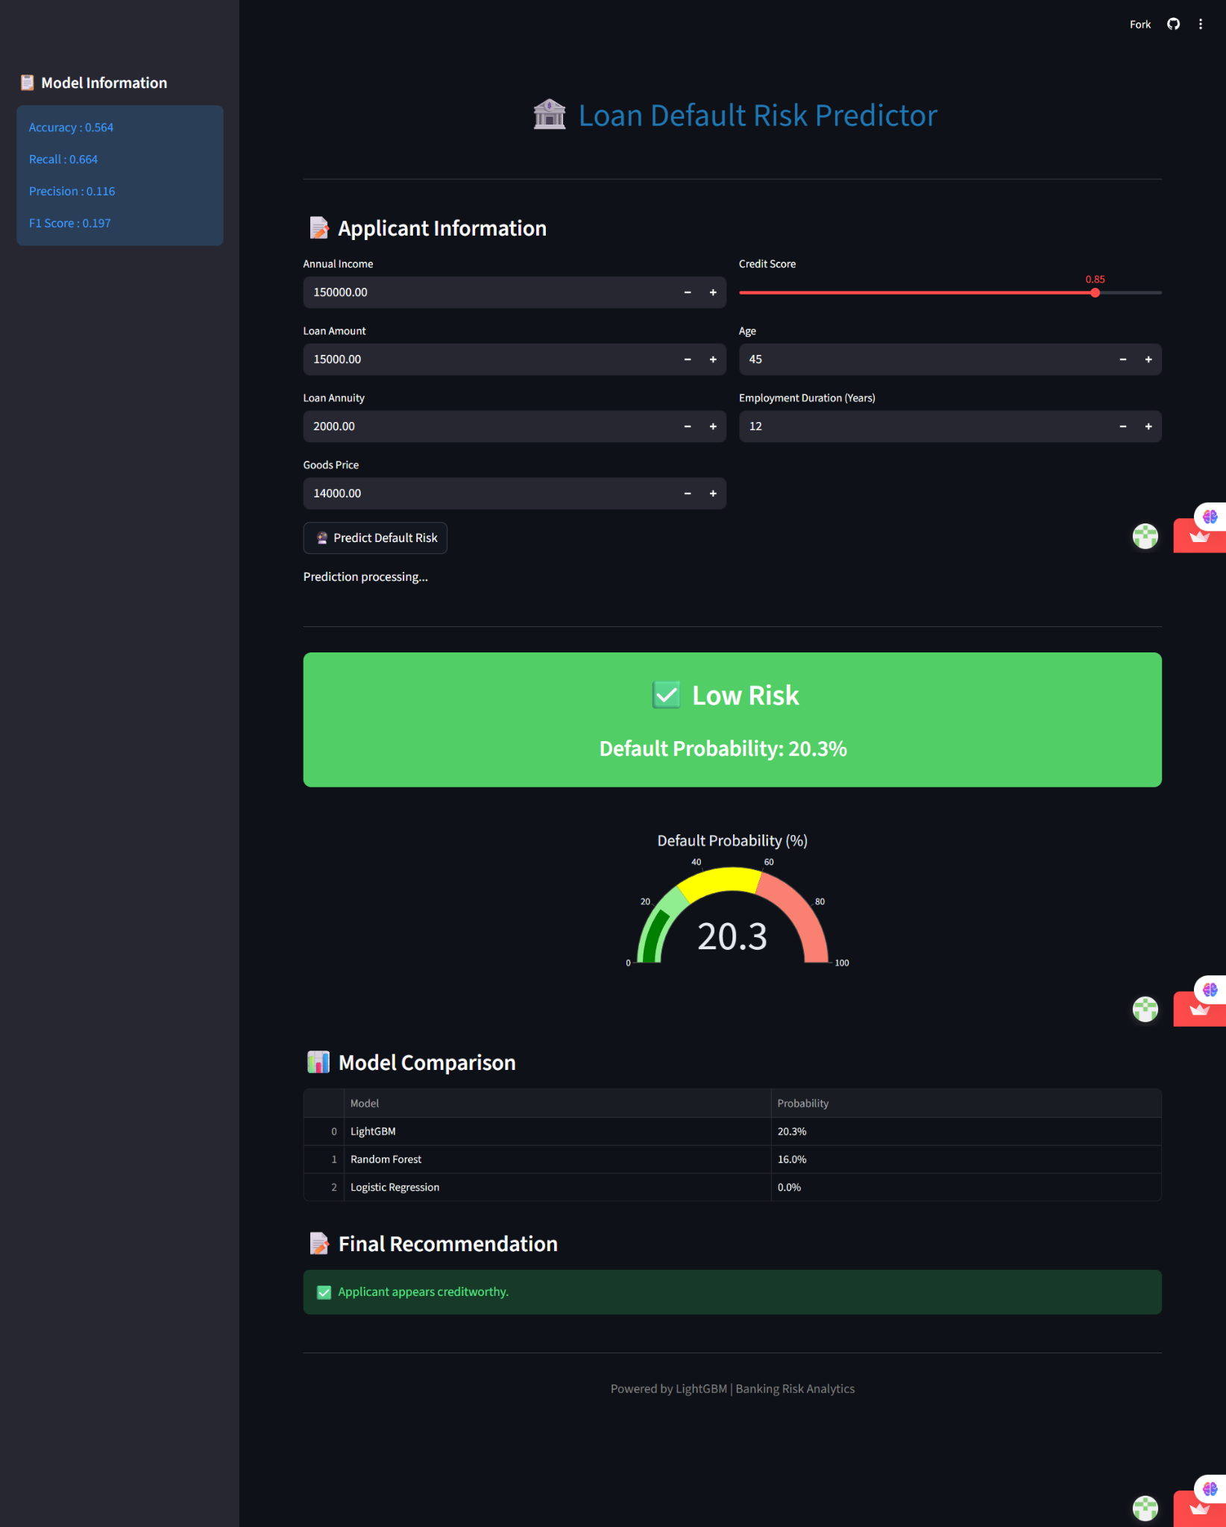
DEPLOYMENT ENVIRONMENT
Low risk

Slide 8
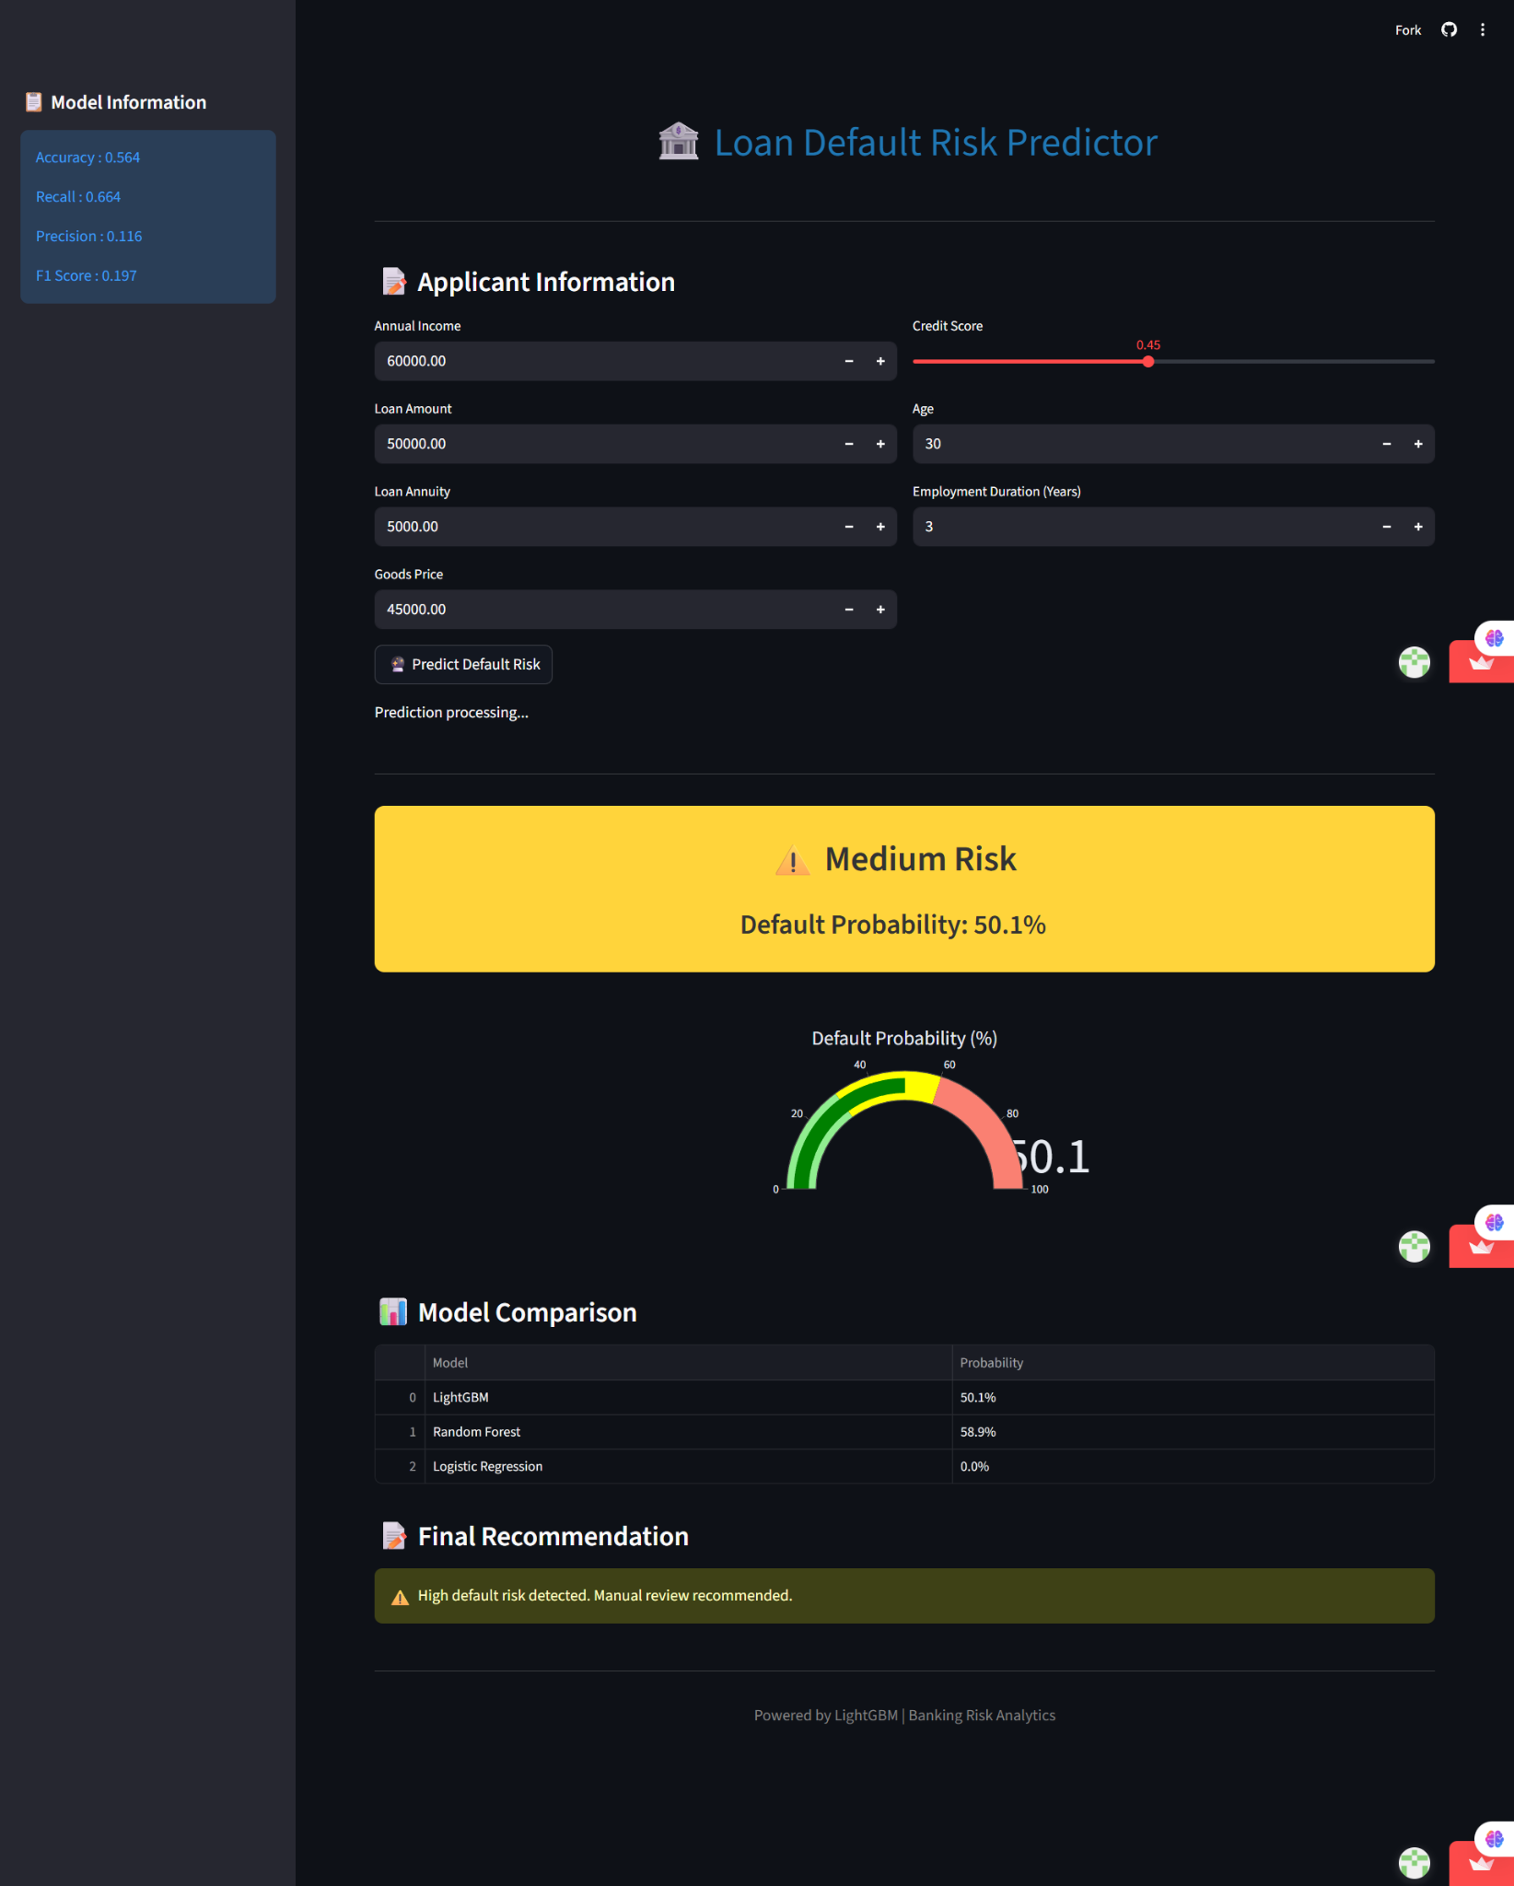
DEPLOYMENT ENVIRONMENT
Medium risk

Slide 9
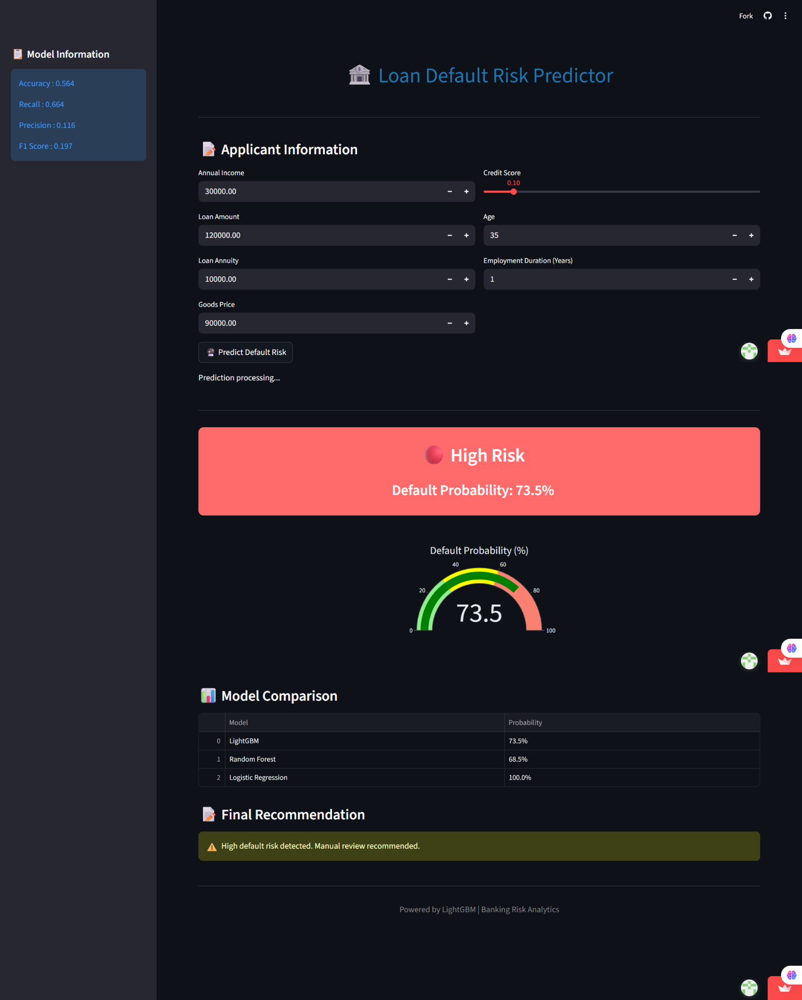
DEPLOYMENT ENVIRONMENT
High risk

Slide 10

STRATEGIC CONCLUSION
Model Impact
Future Scalability
Deploying a model with a Recall of 0.59 allows the institution to flag nearly 60% of potential losses at the intake stage, preserving capital and increasing overall portfolio health.
Future iterations will involve hyperparameter tuning on SMOTE variants and the inclusion of ensemble voting to push Recall closer to the 80% benchmark.
"By prioritizing technical sensitivity over raw accuracy, this framework provides a robust, real-time defense against credit delinquency."

Slide 11

Thank You
Project Team
Sreekutty Santhosh | Laniya Mohan | Theertha Vijayachandran

